Slide 1




Coal and Iron Ore price Forecasting

Slide 2
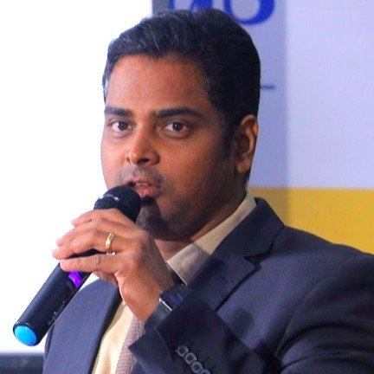

PROJECT LEADERSHIP
Bharani Kumar Depuru
Director at Innodatatics and Sponsor
linkedin.com/in/bharanikumardepuru/
Sharat Manikonda
Director at Innodatatics and Sponsor
linkedin.com/in/sharat-Chandra/

Slide 3

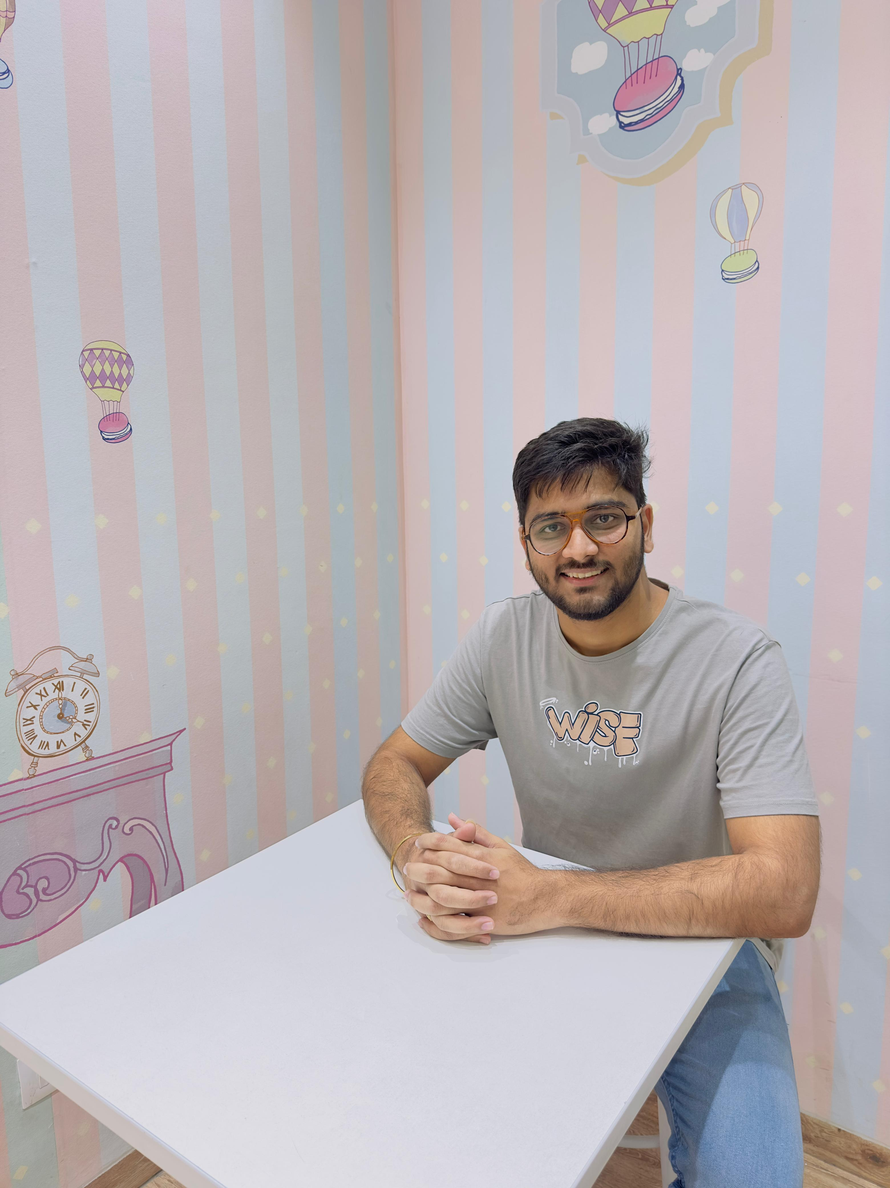
TEAM MEMBERS
Mohd Amer Hussain
Associate Data Scientist @INNODATATICS* Innovation | Data | Analytics
Ashish Patil
(He/Him)
Aspiring Data Scientist @360DigiTMG | Data Analyst | Power B.I | Python | My SQL | EDA | Advance Excel | Learner in A.I & ML |

Slide 4
Overview and Scope
Project Overview:
The project focused on forecasting coal and iron ore prices, considering their high volatility due to supply and demand dynamics, geopolitical events, policy changes, and currency fluctuations. Accurate price predictions aimed to help businesses mitigate risks and stabilize revenue and profit.
Scope:
The project focuses on helping businesses accurately predict future coal and iron ore prices, which are highly volatile due to supply and demand dynamics, geopolitical events, policy changes, and currency fluctuations. The goal is to mitigate revenue and profit risks associated with price volatility.

Slide 5
CONTENTS
Business Objective
Business Constraints
Project Architecture
Data collection and details
Exploratory Data Analysis
Model Building
Evaluation
Deployment
Notes:
Change

Slide 6
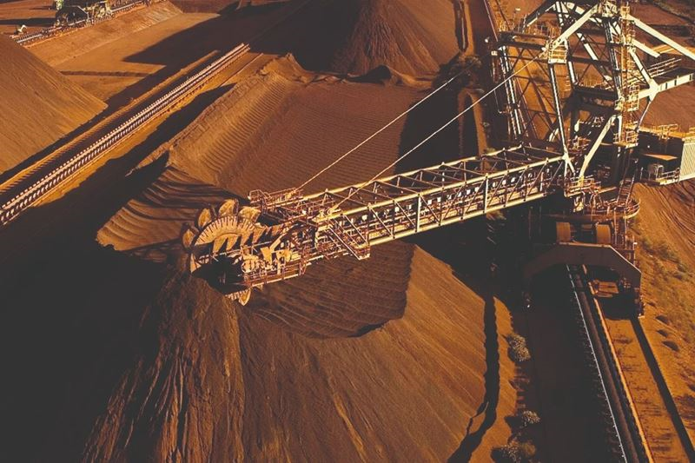
Business Problem
Coal and iron ore prices are highly volatile due to supply and demand dynamics, geopolitical events, policy changes, and currency fluctuations. This makes accurate price predictions difficult for businesses, leading to potential revenue and profit fluctuations.

Slide 7


Business Objective and Constraint
Optimize procurement with accurate price forecasts to maximize savings and profitability.
Minimize the impact of price volatility on production costs

Slide 8
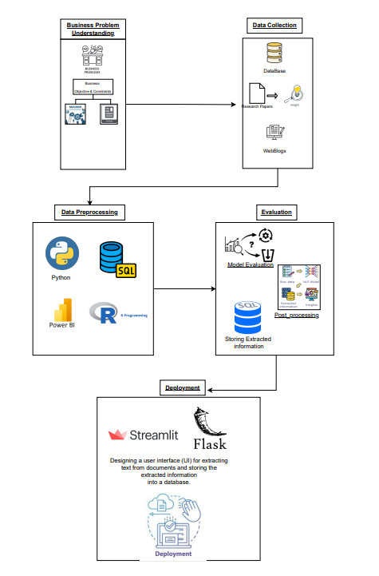
Project Architecture

Slide 9
There are six stages of CRISP-ML(Q) Methodology
1.Business and data understanding
2.Data preparation
3.Model building
4.Model evaluation
5.Model deployment
6.Monitoring and Maintenance
CRISP-ML(Q) Methodology:

Slide 10
Success Criteria
Business Success Criteria:
Achieving a 10% increase in profit margins through optimized procurement and pricing strategies.
Economic success criteria: Generating a 20% increase in revenue from coal and iron ore sales within the first year of implementation.

Slide 11





Technical Stacks
Python : Python is a versatile programming language known for its readability and ease of use.
Development Environment:
-Integrated Development Environment(IDEs) such as Spyder.
Data Storage Tool:
MySQL
Excel
Presentation tool :

Slide 12
Data Collection and Understanding
Data Collection : Data collected from a leading business in the coal and iron ore industry.
Data Understanding:
Data description: The dataset includes features such as,'Coal_RB_4800_FOB_London_Close_USD', 'Coal_RB_5500_FOB_London_Close_USD', 'Coal_RB_5700_FOB_London_Close_USD','Coal_RB_6000_FOB_CurrentWeek_Avg_USD', and 'Coal_India_5500_CFR_London_Close_USD’.
Data Type:
Numerical: Coal_RB_5500_FOB_London_Close_USD,Coal_RB_5700_FOB_London_Close_USD,Coal_RB_6000_FOB_CurrentWeek_Avg_USD, Coal_India_5500_CFR_London_Close_USD.

Slide 13
Data Dictionary
Variable Name | Variable description
Coal_RB_4800_FOB_London_Close_USD | Daily closing prices in USD for Coal RB 4800 FOB in London.
Coal_RB_5500_FOB_London_Close_USD | Daily closing prices in USD for Coal RB 5500 FOB in London.
Coal_RB_5700_FOB_London_Close_USD | Daily closing prices in USD for Coal RB 5700 FOB in London.
Coal_RB_6000_FOB_CurrentWeek_Avg_USD | Average daily closing price in USD for Coal RB 6000 FOB in the current week.
Coal_India_5500_CFR_London_Close_USD | Daily closing prices in USD for Coal from India with 5500 CFR in London.

Slide 14
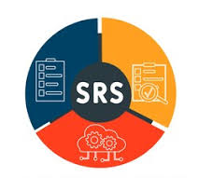
System Requirements
Hardware Requirements:
• Processor: 3 GHz or higher recommended
• RAM: 8 GB or more (increase for real-time processing)
• Storage: Sufficient space for model files, extracted data, and any additional software needs.
Operating System: Windows, macOS, or Linux
Software Requirements:
Python (3.6 or above)
Additional libraries if using specific tools for preprocessing, visualization, etc.

Slide 15
Overview:
Total Records/Data Dimension: [959 rows and 6 columns]
Time Period: [12/04/2024- 12/05/2024]
Libraries Imported:
NumPy, pandas, matplotlib, SQL alchemy, sklearn, scipy, statsmodels, pmdarima, sweetviz, AutoClean, clusteval
Data Preprocessing:
Importing Dataset: Read the dataset from a CSV file and push it into a MySQL database.
Rearranging Dataset: Select and rearrange required columns.
Handling Missing Values: Fill missing values with zeros and perform KNN imputation.
Outlier Treatment: Apply symmetric winsorization to handle outliers.
.

Slide 16
Overview:
Data Transformation: Convert non-stationary data to stationary using differencing.
Exploratory Data Analysis (EDA)Descriptive Statistics: Calculate statistics such as mean, median, mode, kurtosis, skewness, min, max, standard deviation, and variance.
Time Series Analysis: Perform ADF and KPSS tests to check for stationarity.
Seasonal Decomposition:
Seasonal decomposition is performed to break down the time series data into its trend, seasonal, and residual components to better understand underlying patterns and improve forecasting accuracy.
Visualization: Plot time series data along with test results for visual inspection.
Evaluation: Evaluate clustering performance using metrics such as silhouette score.
Model Selection: Choose the best model based on evaluation results.

Slide 17
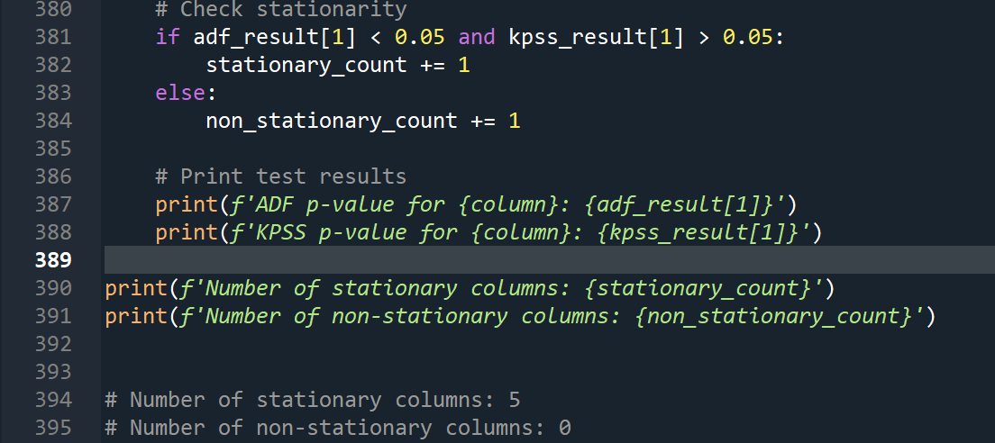
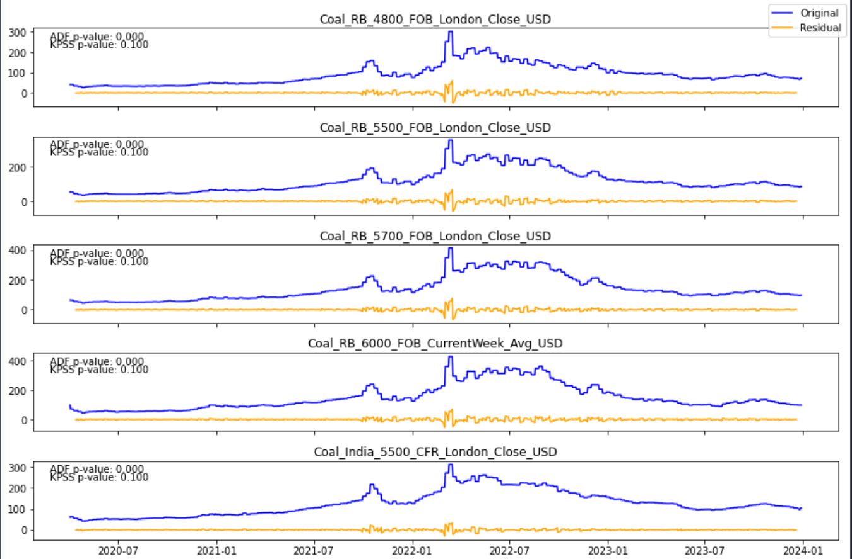
ADF & KPSS testing:
Conducted ADF and KPSS tests for each column.
Plotted time series data with critical values and test statistics using Matplotlib.
Identified stationary (0) and non-stationary (5) columns via ADF and KPSS tests.
Converted non-stationary columns to stationary using differences and saved as "complete_stationary.csv".
Highlighted the need to validate results with alternative tests for large sample sizes.
Merged non-stationary columns into one stationary dataset for analysis.

Slide 18
Model Building
Models Implemented: ARIMA, SARIMA, Random Forest,GBM, LSTM.
Models Tried: Prophet (didn’t proceed because import error)
Parameter Tuning: Utilized specific parameters for each column.
Evaluation Metrics: Evaluated models using Mean Absolute Percentage Error (MAPE). Aimed for less MAPE score for model selection.
Result Aggregation: Merged results from different models.Selected best models based on MAPE comparison.
Final Model Selection: Chose the best-performing model for whole dataset. Considered lower MAPE and ensured robust predictions.
Deployment Ready: Prepared for deployment with accurate forecasting models, ensured models are stored for future use.
Continuous Improvement: Kept scope for future model enhancements, aimed for ongoing monitoring and optimization.
Result Tracking: Tracked the count of MAPE score for assessment.
Ensured model performance aligns with expectations.

Slide 19
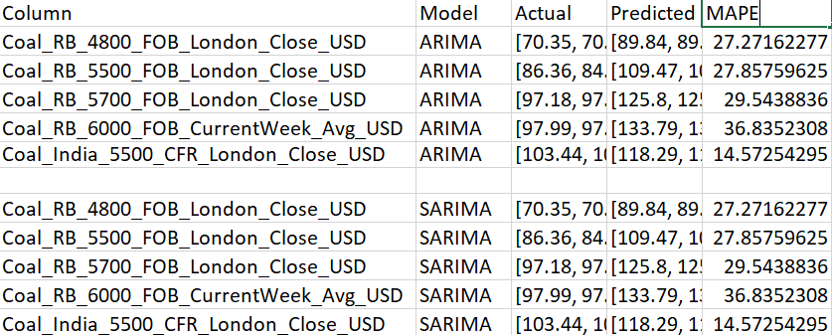
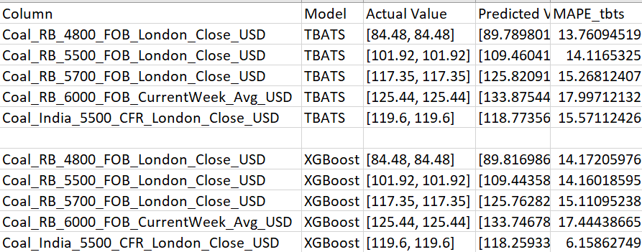
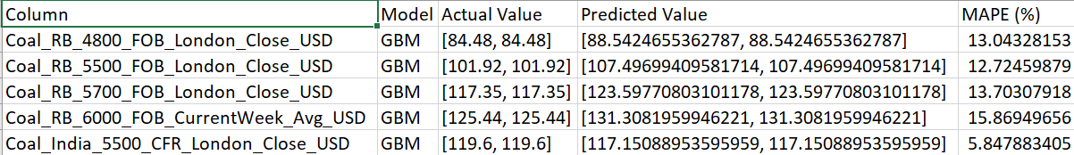
Model Accuracy Comparison
Using ARIMA_and SARIMA_Model
Using XGBoostand TBTS_Model
Using GBM_Model

Slide 20

Model Deployment - Strategy
Approach:
Data Preprocessing: Load and preprocess dataset. Rename columns and set datetime index. Model Loading: Load pre-trained models. Handle missing model files gracefully. Streamlit Interface: Create Streamlit app titled "Time Series Forecasting". Enable column selection and future points input. Forecasting: Use selected model for forecasting. Handle forecast errors robustly
Display Predictions: Present future predictions in a table.
Ensure non-negative predictions: Error Handling: Provide clear error messages. Ensure smooth app functionality.
User Interaction: Intuitive dropdowns and sliders for user input. Ensure user-friendly experience.
Result Presentation: Clearly present forecasted data. Maintain data coherence and integrity.

Slide 21
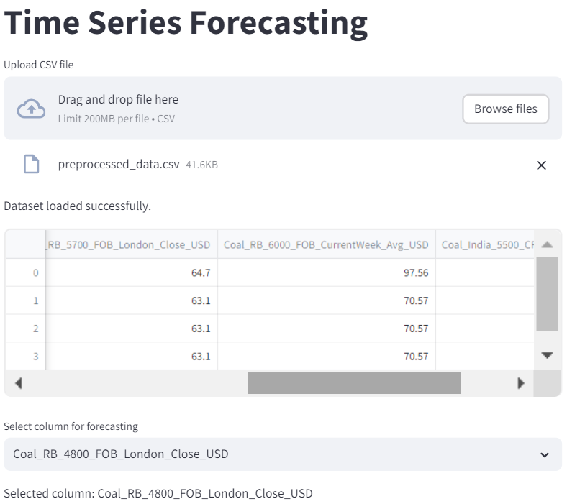
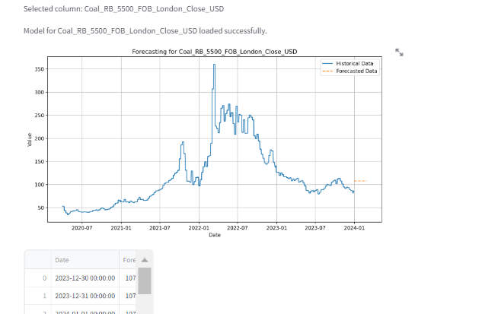
Output Screenshot

Slide 22

Challenges
High Volatility: Prices fluctuate significantly due to supply and demand changes, market disruptions, and geopolitical events.
Geopolitical Risks: Changes in government policies and international tensions can affect prices and supply chains.
Currency Fluctuations: Exchange rate changes impact global trading prices of coal and iron ore.
Data Quality: Inaccurate or incomplete data can lead to unreliable forecasts.
Technological Risks: Integrating new technologies involves technical glitches, integration challenges, and cybersecurity threats.
Market Trends: Predicting customer preferences and market trends is difficult in dynamic environments.
Regulatory Compliance: Environmental regulations and sustainability standards add complexity to forecasting models.
Lead Time Variability: Variable lead times in extraction and delivery affect forecast accuracy.
Coordination: Effective communication and coordination among stakeholders are crucial for accurate forecasting.
External Factors: Weather, economic trends, and innovations in alternative energy sources add uncertainty to forecasts.

Slide 23

Future Scope
In the future, this project holds the potential to revolutionize not only automotive manufacturing but also various other industries by leveraging advancements in technology and sustainable practices. By integrating emerging technologies like AI, IoT, and blockchain, we can create smarter and more efficient supply chains that not only optimize distribution processes but also minimize environmental impact. The project's scope extends to global supply chain optimization, collaborative networks, and customer-centric strategies, all aimed at delivering enhanced value to customers while driving innovation and sustainability across the supply chain ecosystem.

Slide 24

Conclusion
Volatility: Prices fluctuate significantly due to supply, demand, and market disruptions.
Geopolitical Risks: Changes in government policies and international tensions can affect prices.
Data Quality: Inaccurate or incomplete data can lead to unreliable forecasts.
Market Trends: Predicting customer preferences and market trends is difficult in dynamic environments.
Coordination: Effective communication and coordination among stakeholders are crucial for accurate forecasting.

Slide 25

Thank You

